Slide 1


Learn Azerbaijani very easy for Eurovision in Baku by Fərhad və Qorxmaz
Qəşəng sponsor

Slide 2
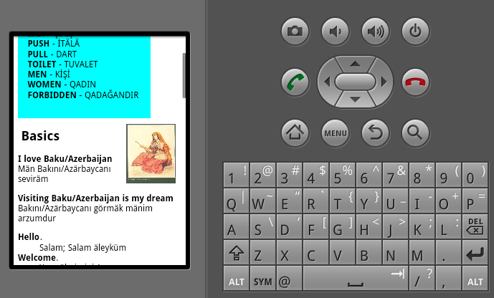
Very simple application to help foreign people learn basics words in Azerbaijani

Slide 3
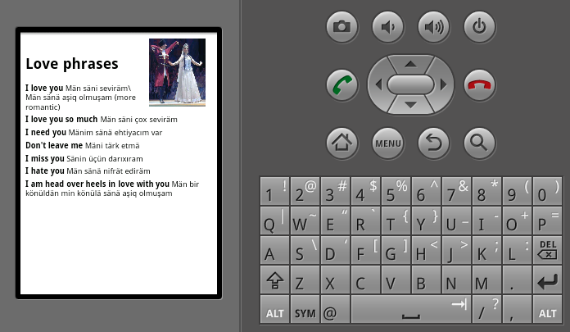
Application also has several common pictures about culture of Azerbaijan

Slide 4
Thank you

